Slide 1
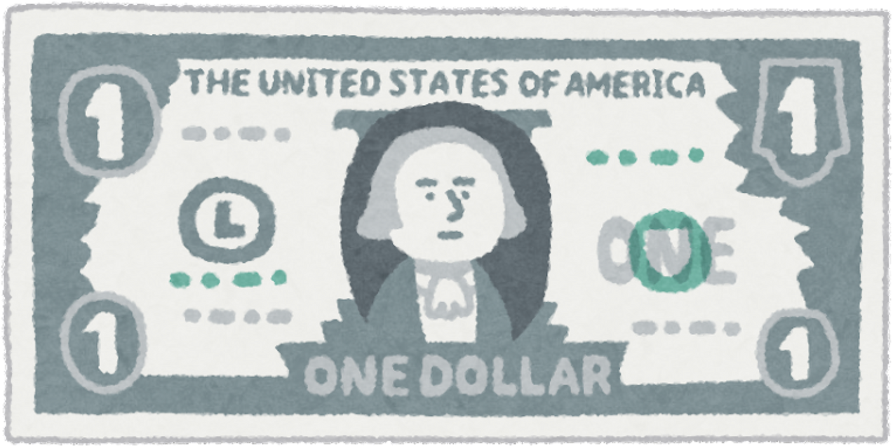
FinBuddy - Best Finance Teacher with Live Company Data
NLP-FTP by:
Bharat Khandelwal
Instructor :
Amir Jafari
GROUP-9

Slide 2
Methodology
Scrapped financial terms and definitions using selenium.
Created a fine tuning dataset of the form instruction and output.
Fine tuned the model using QLoRA technique.
Developed FAISS embeddings of company dataset with ticker symbols.
Built a RAG pipeline to give live data about companies’s stocks data.
Developed the chatbot with UI using StreamLit.

Slide 3
LLM MODEL
1. Lightweight Yet Powerful
Mistral 7B Instruct delivers competitive performance on par with larger models like LLaMA-2-13B while being significantly smaller, making it highly efficient for deployment on limited hardware.
2. Optimized for Instruction Following
Mistral 7B Instruct excels at understanding and completing user instructions, making it ideal for chatbots, education tools, and task-oriented applications.
3. Open-Source and Customizable
As an open-weight model, Mistral 7B Instruct allows full transparency and fine-tuning flexibility.

Slide 4
Fine Tuning
Objective: Trained the Mistral-7B-Instruct model using QLoRA to explain financial terms with child-friendly analogies and simple real-world examples.
Setup: Used ~3,200 curated prompt-response pairs with LoRA (Rank=16) and 4-bit quantization to fine-tune just 0.19% of model weights efficiently.
Outcome: Produced a lightweight, adapter-based model that retains core knowledge while adapting its teaching styleto be more accessible and engaging.

Slide 5
RAG SETUP
Downloaded the csv from stock Analysis for company names and it’s tickers.
Created FAISS(Facebook AI Similarity Search) for matching the company names in the query to get the ticker and thus to extract data from Yahoo Finance.
Summarizing using the LLM to give an explanation of the values that we see.

Slide 6
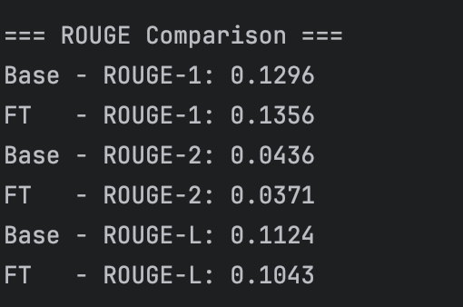
Rouge Score Comparison
The fine-tuned model showed a higher ROUGE-1 score (0.1356 vs. 0.1296), indicating better alignment with analogy-based reference phrases at the word level.
This suggests the model has started adopting the intended teaching style and vocabulary.
Slight drops in ROUGE-2 and ROUGE-L reflect fewer bigram overlaps, may be due to the model rephrasing analogies or not fully completing them.
Despite minor ROUGE dips, the fine-tuned model likely preserves conceptual clarity using different but valid expressions.

Slide 7
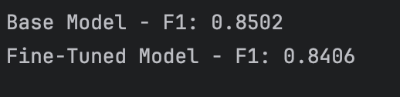
Bert Score Comparison
The fine-tuned model maintains a high BERTScore (F1: 0.8406), nearly matching the base model (F1: 0.8502), showing minimal loss in meaning despite changes in wording.
A slight dip in BERTScore is expected as the fine-tuned model was trained to produce simpler, analogy-rich responses rather than precise text matches.
Confirms model still understands Finance concepts aligned with the goal of building a teaching-oriented AI assistant.

Slide 8
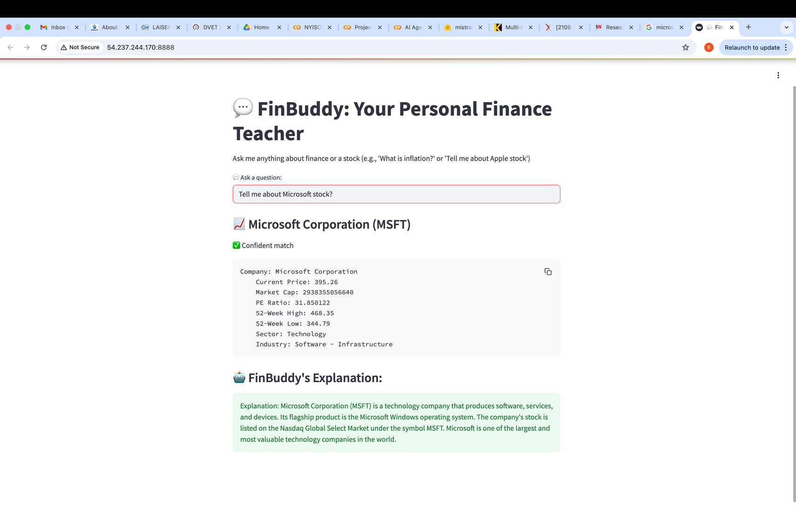
RESULTS

Slide 9
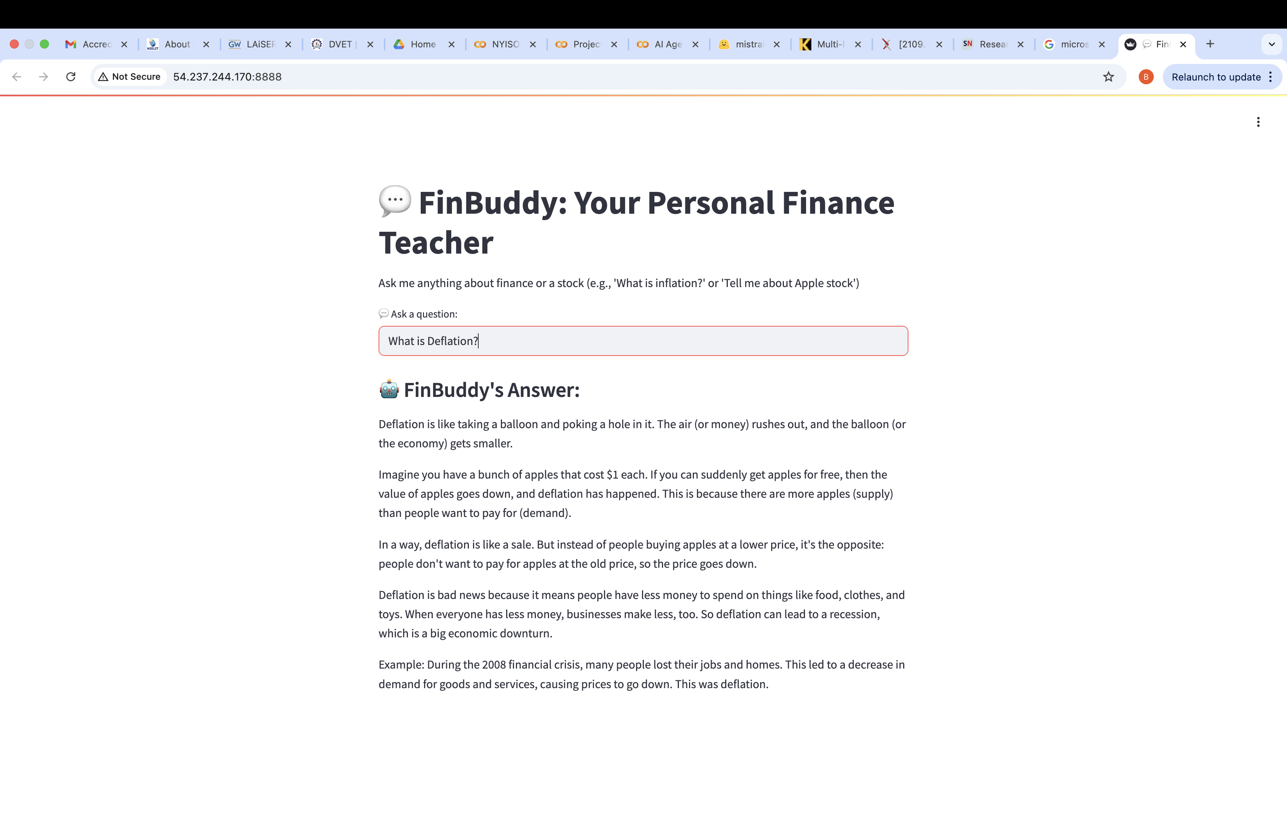
RESULTS

